Slide 1


First order ordinary differential equations

Slide 2
Methods to solve first order ode
SEPARABLE EQUATION
REDUCEABLE TO SEPARABLE (HOMOGENEOUS EQUATION)
EXACT EQUATION
REDUCEABLE TO EXACT EQUATION (INTEGRATING FACTOR)

Slide 3
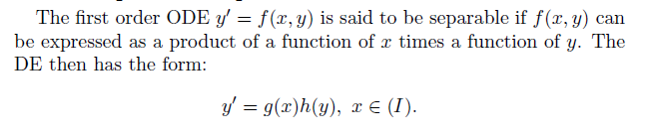
SEPARABLE EQUATION

Slide 4
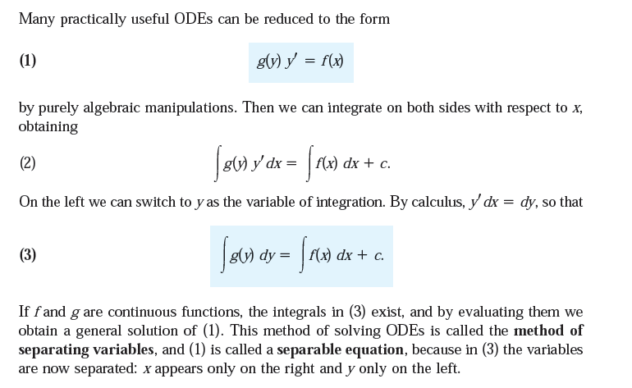

Slide 5
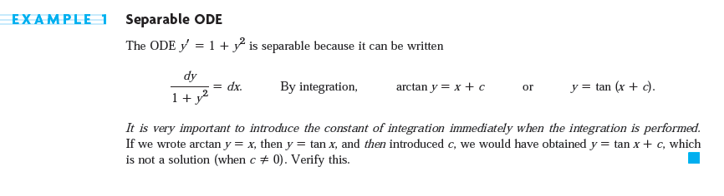

Slide 6
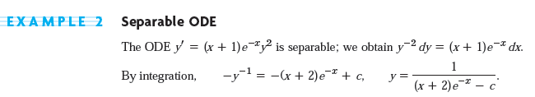

Slide 7
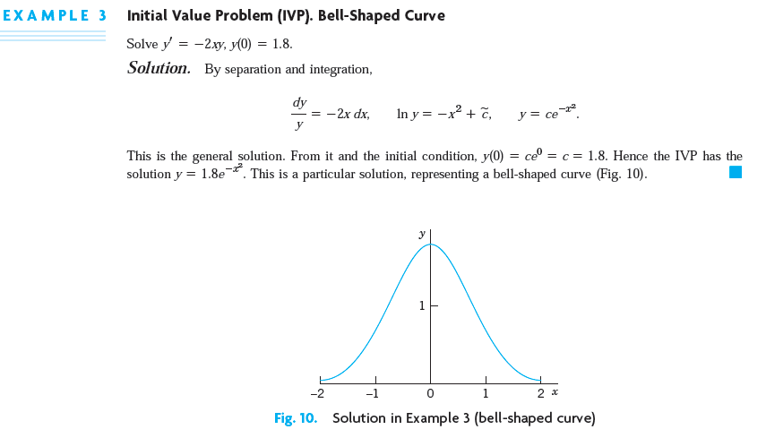

Slide 8
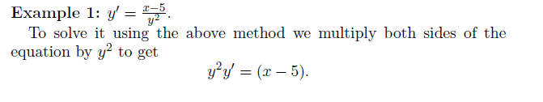
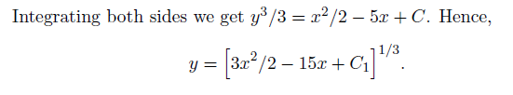

Slide 9
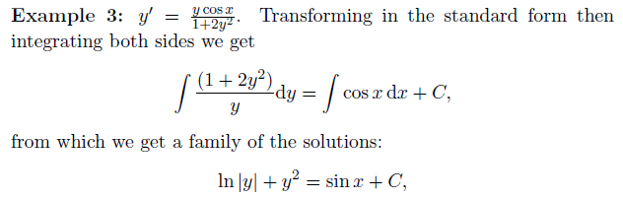

Slide 10
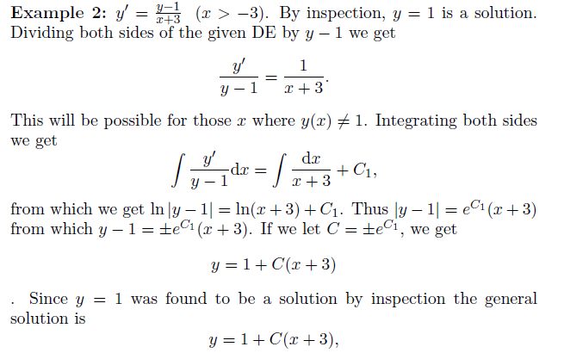

Slide 11
